Slide 1
The experiments based on word-embedding and SVM
2018-09-10 Raymond ZHAO WENLONG

Slide 2
Content
Background
Updates on experiments
Mean of word embedding + SVM classifier
Metrics
Next steps

Slide 3
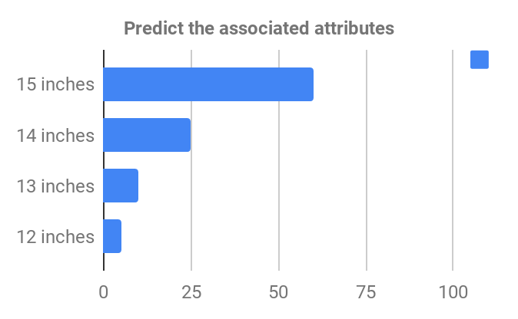
Background
develop a new product configuration approach in e-commerce industry to elicit customer needs
collect Amazon user reviews (laptop), and suppose these reviews as user inputs ( Sentiment Analysis?)
query-to-attributes mapping:
map user inputs (the functional requirements in unstructured query) into product parameters or features (structured attributes)
classification problem in ML
large Screen Size laptop

Slide 4
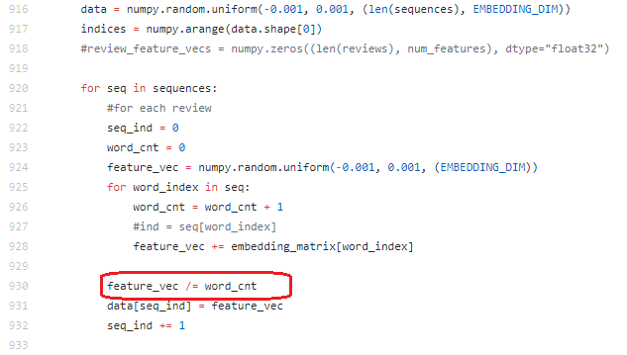
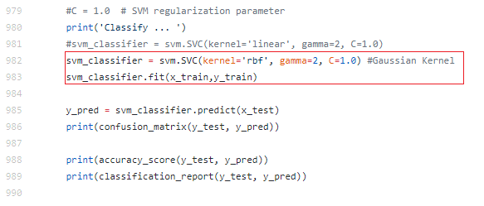
The experiments
Mean of word embeddings in each user review
use pre-trained Glove word embeddings
represent words using low-fixed-dim vector
capture word relations via inner products
SVM multi-classifier in ML
scikit-learn lib

Slide 5
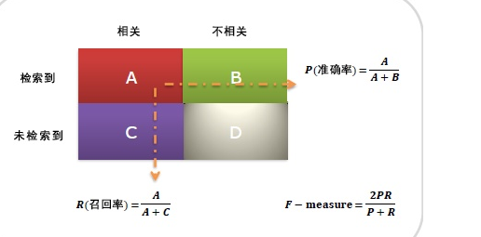
Metrics in ML
Accuracy = (A+D) / Total
correct predictions out of all total examples
Precision = A / (A + B)
what proportion of positive identifications was actually correct?
“這個預測多少是對的”
Recall = A / (A + C)
what proportion of actual positives was identified correctly?
“正例里這個預測覆蓋了多少”
F1
seek a balance between precision and recall
reference from 知乎

Slide 6
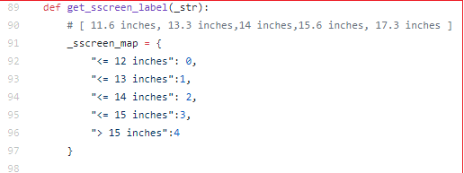
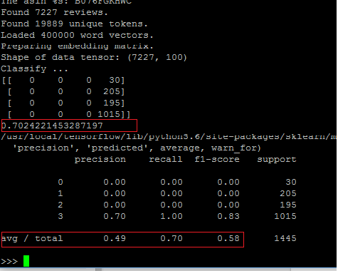
Metrics
parameter:
screen size (for example)

Slide 7
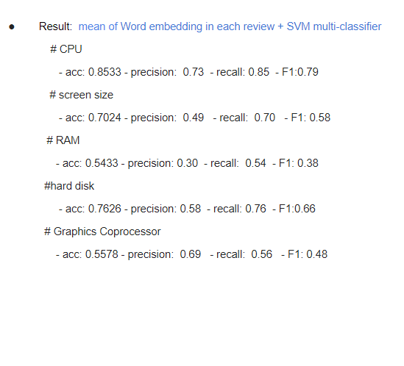
Metrics
The current experiments

Slide 8
TODO
Large-scale dataset
Scrape data from HP/DELL/ebay website
Chinese Text Dataset?
DL model - LSTM model?
reference “Predicting Latent Structured Intents from Shopping Queries” in 2017, World Wide Web

Slide 9
Thanks

